Slide 1
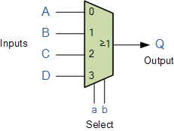
Multiplexer
Multiplexer(MUX) is a device that has multiple input and a single output.
It is a combinational circuit that receives binary information from one of 2^{n} input data lines and directs it to a single output line.
Input line is selected on the basis of Select Lines.

Slide 2
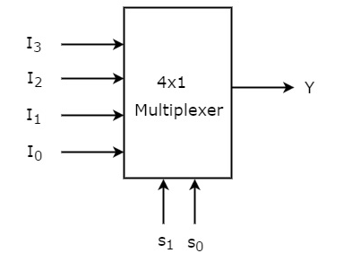
4x1 Multiplexer
Example:
4x1 Multiplexer has four data inputs I₃, I₂, I₁ & I₀, two selection lines S₁ & S₀ and one output Y. The block diagram of 4x1 Multiplexer is shown in the following figure.
Selection Lines |  | Output
S₁ | S₀ | Y
0 | 0 | I₀
0 | 1 | I₁
1 | 0 | I₂
1 | 1 | I₃
Notes:
The rotary switch, also called a wafer switch as each layer of the switch is known as a wafer, is a mechanical device whose input is selected by rotating a shaft.
In other words, the rotary switch is a manual switch that you can use to select individual data or signal lines simply by turning its inputs “ON” or “OFF”. So how can we select each data input automatically using a digital device.

Slide 3
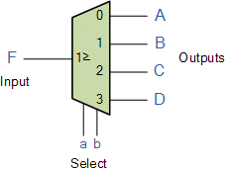
Demultiplexer
The demultiplexer is a combinational logic circuit designed to switch one common input line to one of several separate output line.
Notes:
We can implement this Boolean function using Inverters, AND gates & OR gate.
We can easily understand the operation of the above circuit.

Slide 4
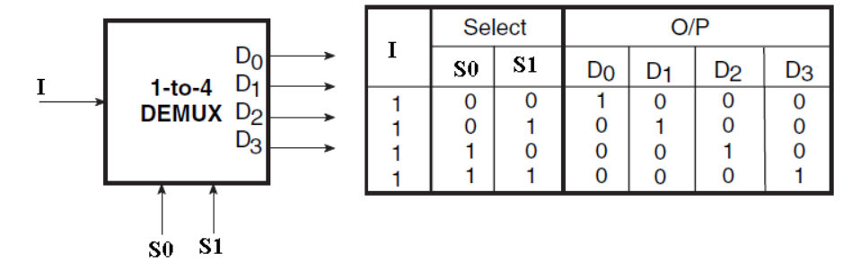
1x4 Demultiplexer

Slide 5
Decoder
  Decoder is a combinational circuit that has ‘n’ input lines and maximum of 2^{n} output lines.
  One of these outputs will be active high based on the combination of inputs present.

Slide 6
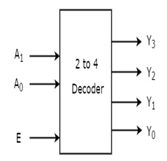
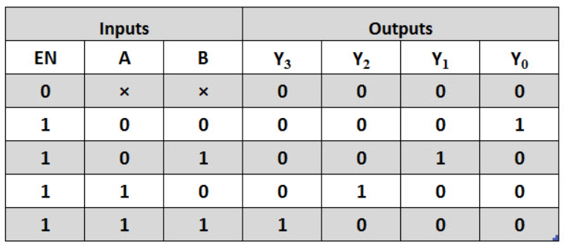
Decoder
Example:
Let 2 to 4 Decoder has two inputs A₁ & A₀ and four outputs Y₃, Y₂, Y₁ & Y₀. The block diagram is given below.

Slide 7
Encoders
An Encoder is a combinational circuit that performs the reverse operation of Decoder.
It has maximum of ‘2^{n}’ input lines and ‘n’ output lines.

Slide 8
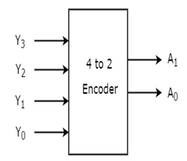
Encoders
4 to 2 Encoder
Let 4 to 2 Encoder has four inputs Y₃, Y₂, Y₁ & Y₀ and two outputs A₁ & A₀. The block diagram of 4 to 2 Encoder is shown in the following figure.
Inputs |  |  |  | Outputs
Y₃ | Y₂ | Y₁ | Y₀ | A₁ | A₀
0 | 0 | 0 | 1 | 0 | 0
0 | 0 | 1 | 0 | 0 | 1
0 | 1 | 0 | 0 | 1 | 0
1 | 0 | 0 | 0 | 1 | 1

